Slide 1
Team 5 Conceptual Design
Dillon Williams
Nidhay Patel
Ryan Reed
Michel Turpeau
Austin Sigg

Slide 2
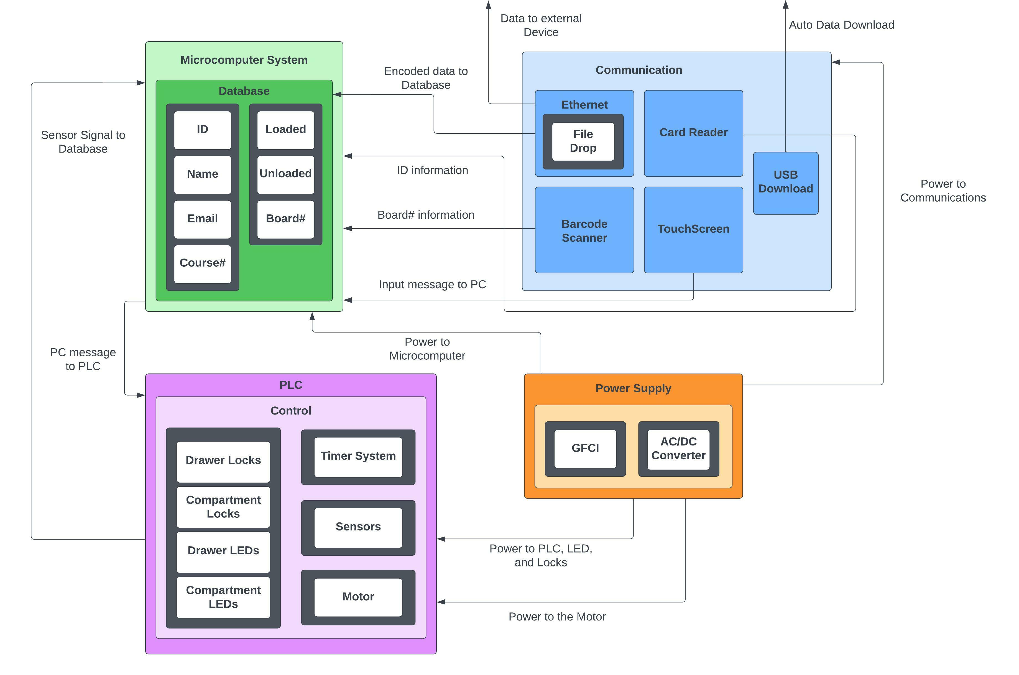

Slide 3
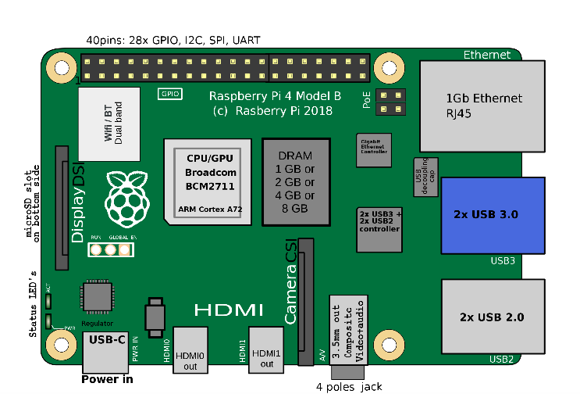
Microcontroller
Raspberry Pi Model 4 B
Card Reader
Input: Signal/Message/Information from Eagle Card
Output: Create Data and signal Microcontroller Unit
UI
Raspberry Pi LCD touchscreen
Input: Information from Student
Output: Raspberry Pi signaling PLC

Slide 4
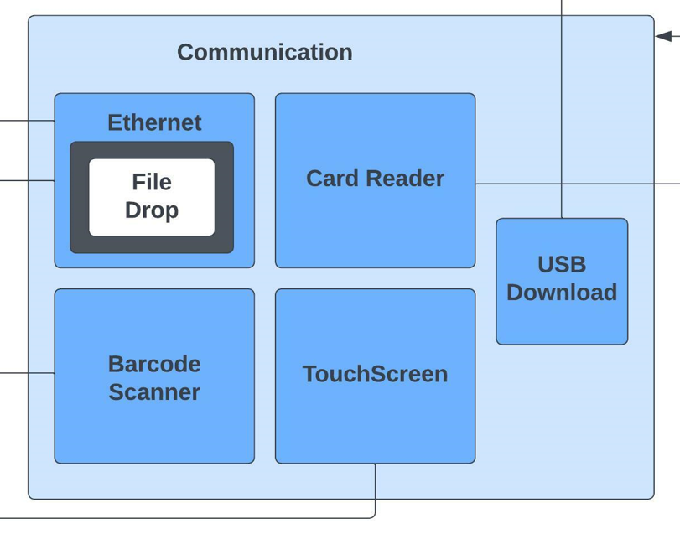
PC connections
miniPC
SQL Database
Touchscreen
Eagle Card Reader
Ethernet
USB

Slide 5
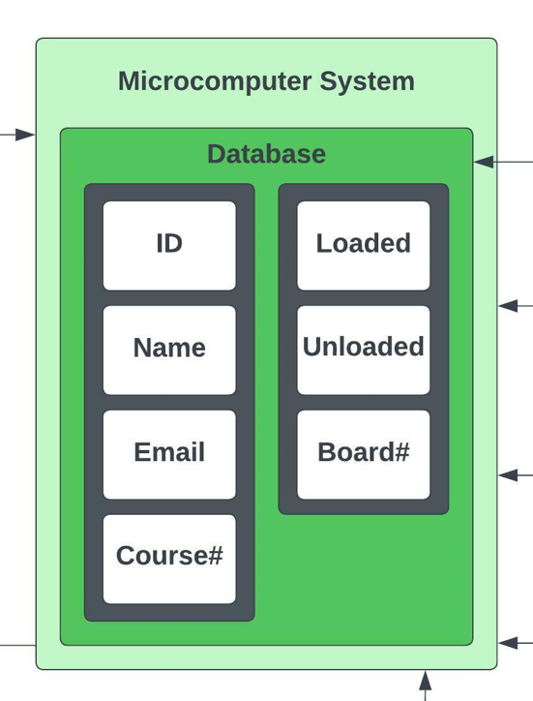
SQL Database
Inventory
Loaded
Unloaded
Student Information
T#
Name
Email
Course & Board#
Ethernet
CSV File

Slide 6
Constraints
USB
Database
Card Scanner
Be able to automatically transfer data to the faculty’s thumb drive when inserted into the machine
Have a created Schema available and have a server to contain the student data and Schema itself
Be able to read data from Eagle Cards and store the identifier in the database for faculty use

Slide 7
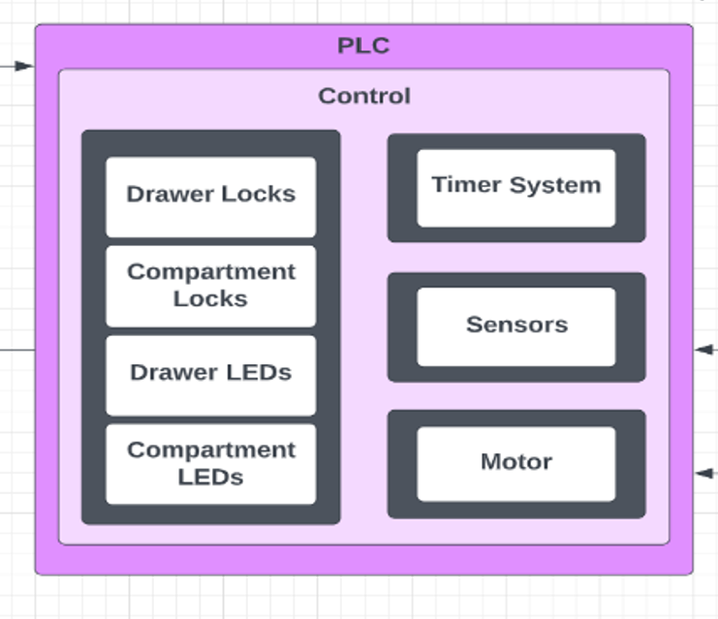
Hardware connections
PLC
HW Control
Locks
Indication
Timer System
Sensors (Addressed later)
Motor

Slide 8
Why a plc & a microcomputer?
PLC’s “run-to-completion” step is Cycle-Driven!
Will always scan its code on a given interval (ex. every 100ms)
A microcomputer is event-driven: will complete its scan once an event is activated
Could be SIGNIFICANTLY longer
PLCs are used in industry specifically for control technology
Almost all hardware in industry can be easily controlled by PLCs
Makes controlling fewer components much more simple
If PLCs can do this, why not use it for a database?
PLCs aren’t good with sharing a lot of data, except for HMIs and DAQs
Can’t understand SQL

Slide 9
Plc Control / Hardware
PLC Constraints
ii(1) Must interface with the locks and LEDs
ii(2) Must control the step voltage of the motor(s)
ii(3) Must communicate with the microcomputer
ii(4) Must know the device occupancy of each drawer
ii(5) Must have a timer system
Hardware
PLC receives power from wall outlet
Hardware receives all control from the PLC
Sensors, Locks, Timer System, Indication System, Motor

Slide 10
Hardware subsystems
Stepper Motor
PLC will control driver for motor
Motor steps enough degrees to rotate new device to drawer
Locks
Most likely solenoid (Proposed by MechE team)
Powered by DC voltage
Indication System
Most likely LEDs. Will help guide student to correct drawer and compartment
Controlled by PLC
Timer System
Used to flash LEDs and unlock compartments over a predetermined duration
Controlled by PLC
Will be a system to alternate TON timers

Slide 11
Explanation for Stepper Motor

Slide 12
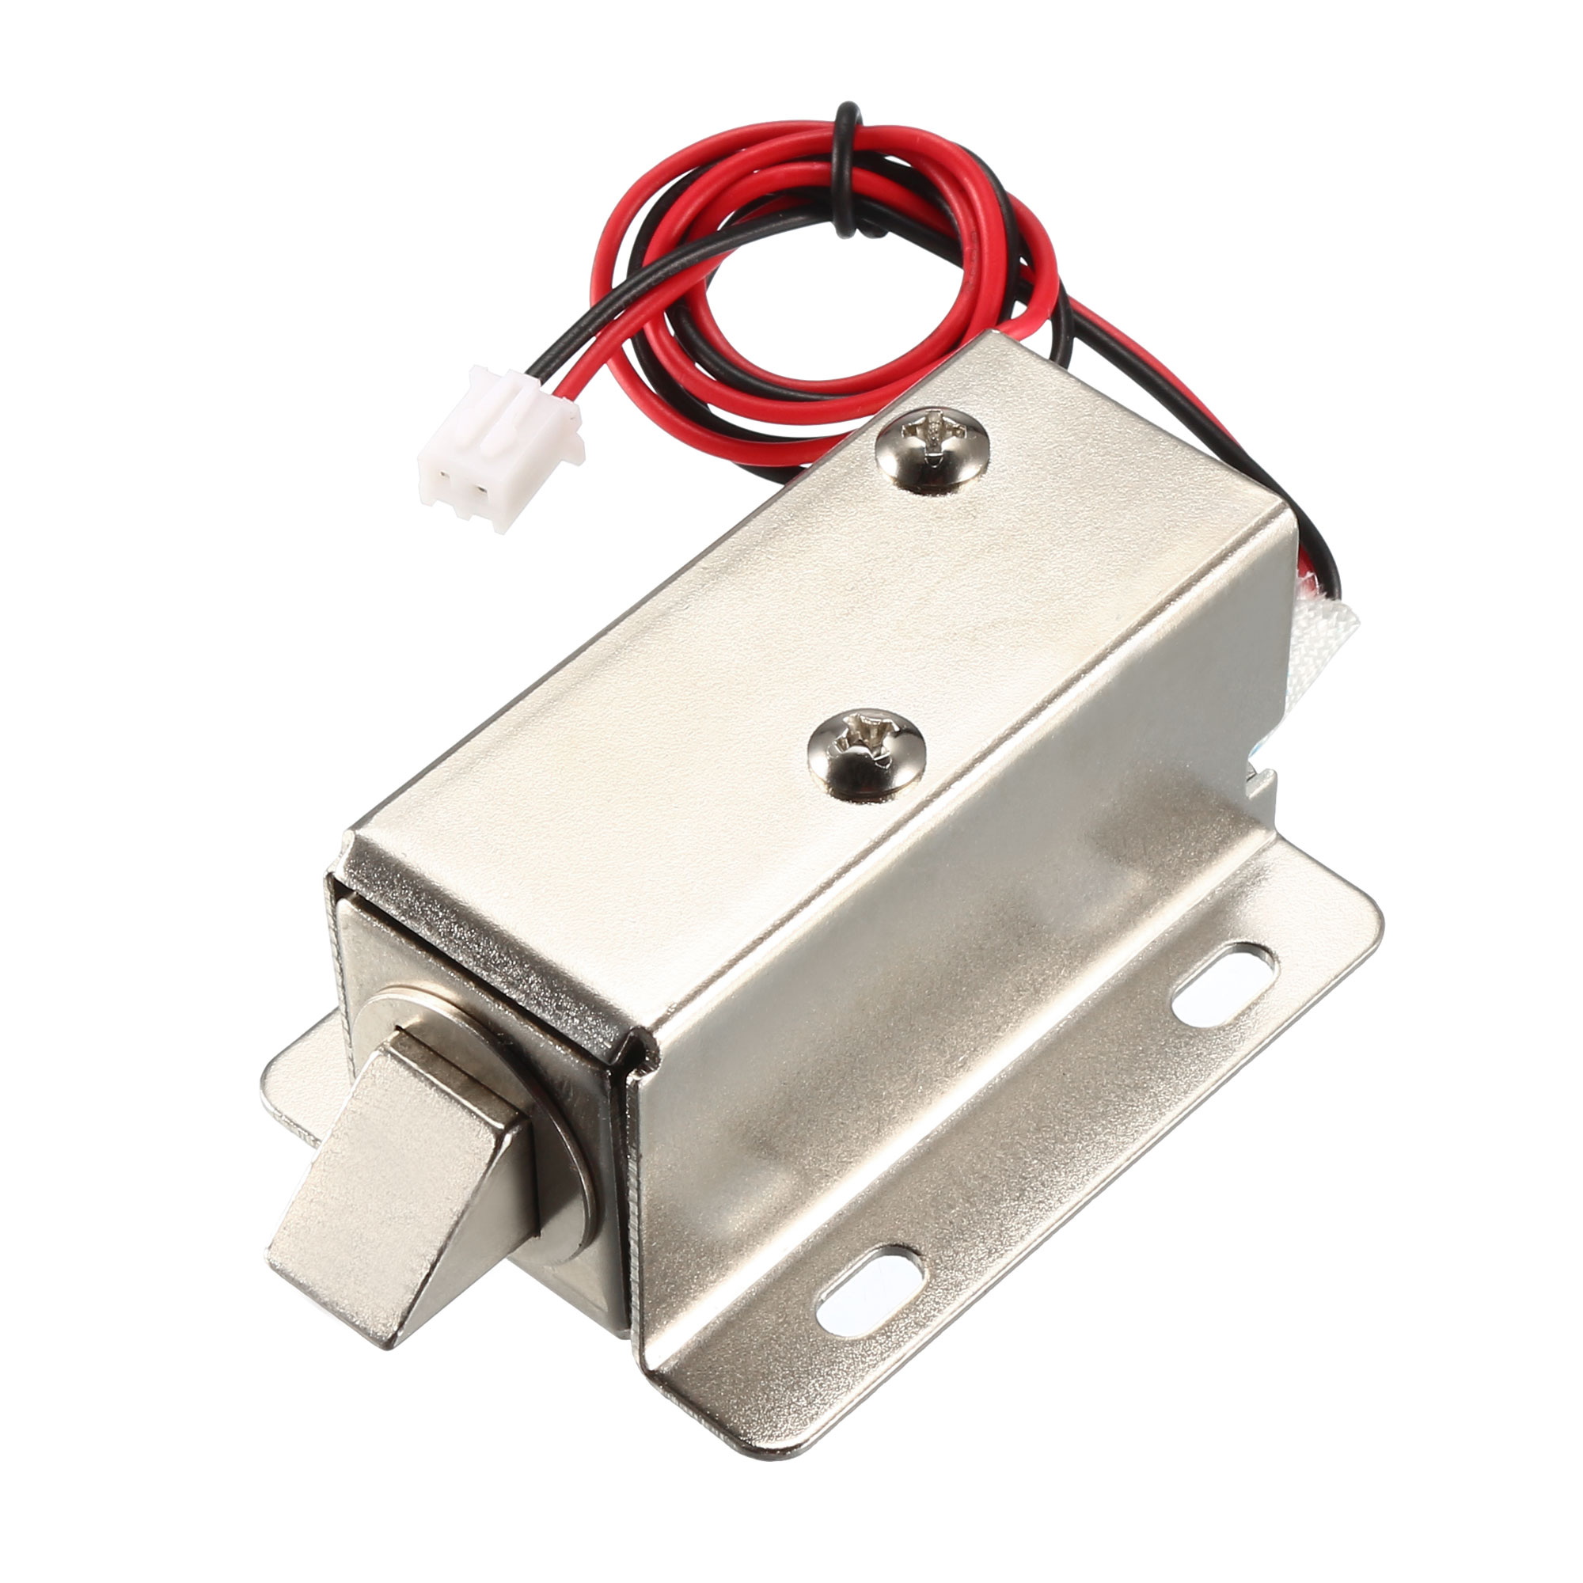
Locks
Main security for the physical system.
Locks for each of the drawer, and for each of the compartments.
The drawers will require more strength, since they are directly exposed and easy to grab a hold of.
Needs to stay lock when power is lost.

Slide 13
LEDs and Indicators
To assist the user, both the operator and the consumer, there will be a series of LED indicators guiding them to the designated compartment.
User Mode (For Consumer):
After successfully completing the rental process the LED will flash, indicating the drawer and the compartment that the item is stored.
Once the item is removed and the compartment and drawer are closed, the LEDs turn off.

Slide 14
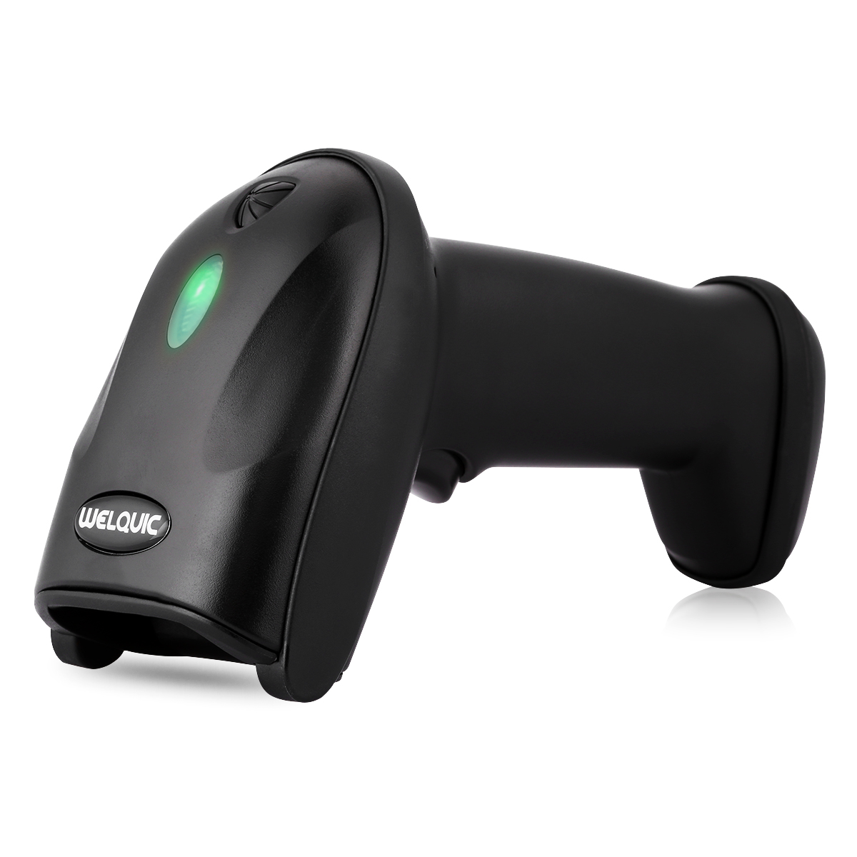
Barcode Scanner
Used to scan in the ID/barcode attached to the device’s box.
Makes it easy to keep track of items have been registered to the database.
Will be used by the operator during the “LOAD” mode.

Slide 15

LOAD Mode
Mode loading and registering items to the machine.
The machine is aware of empty compartment.
LED indicators will inform the user of the compartment that needs a new item. (The only ones unlocked)
The user CANNOT move on to the next drawer until they have scanned in the device and loaded it into its compartment.

Slide 16
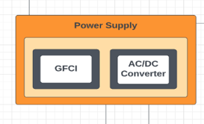
Power
Power Supply
AC/DC Converter
Overcurrent Protection
GFCI-protected outlet
NEC 422.51
Circuit Breaker
Fuses
Op-Amp Circuits
Constraints:
iv(1) As per the standard NEC 422.51, the power system must have a ground fault current interrupter (GFCI) to protect against the current surge.
iv(2) The power system must have an AC/DC converter to send power to the voltage-sensitive components.
iv(3) The power system must have an emergency stop control.

Slide 17

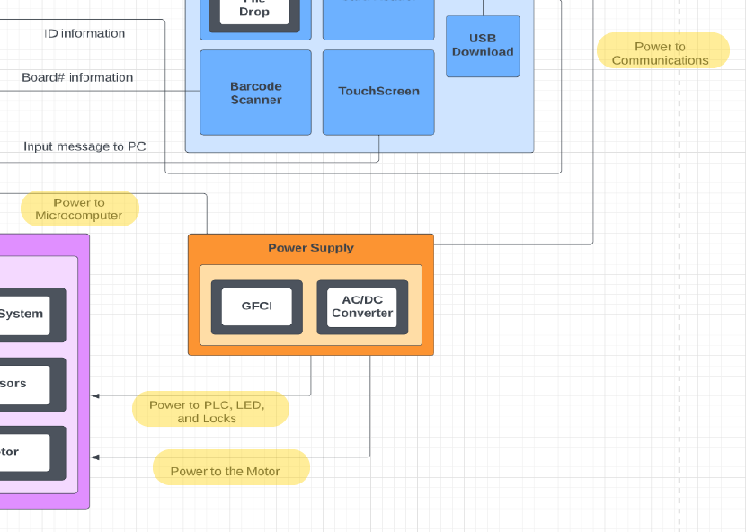
Systems that require Power
Microcomputer
PLC
Motor
LEDs
Locks
Barcode Scanner
Card Reader

Slide 18
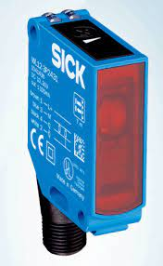
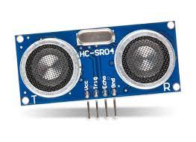
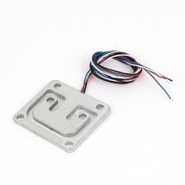
Sensors
To determine occupancy of each compartment
Hundreds of options to consider
Ideals
Small Size
One bit output
Cheap
Easy Calibration
Constraints: iii(4) The PLC must know the device occupancy of each drawer.

